Slide 1
C. D. BROAD ON RELIGIOUS EXPERIENCE (CONT.’)

Slide 2
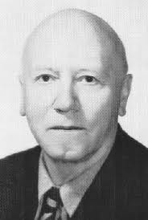
CHARLIE DUNBAR BROAD (1887 –1971) epistemologist, historian of philosophy,philosopher of science, moral philosopher.

Slide 3
ANALOGY BETWEEN EAR FOR MUSIC AND SUSCEPTIBILITY TO MYSTICAL EXPERIENCE
There are a number of significant analogies between various ways of studying the one and the other, but the important disanalogy (according to Broad) is that mystical experiencers claim to come to know that something is true or probable as a result of their experience.

Slide 4
THIRD PROBLEM ABOUT RELIGIOUS EXPERIENCE – THE DISANALOGY
Part of the content of some religious experiences is alleged knowledge (or well-founded belief) about the nature of Reality.
Are such experiences veridical – or at least true and probable?

Slide 5
DISANALOGY?
Is Broad right about this? It depends on the answer to a question about Aesthetics (a sub-discipline of Philosophy). Are there objective facts about Beauty and Aesthetic Value?

Slide 6
PSYCHOLOGICAL ANALYSIS, GENETIC AND CAUSAL FACTORS
In certain circumstances, psychological analysis , genetic and causal factors may support a negative answer to our third question. So the three sorts of questions are not really independent.

Slide 7
BROAD’S CONFESSION
If some “aesthetic Philistine” were to make pronouncements about aethetic value and to propose theories about the nature and causation of musical experience, then his views should be viewed with suspicion.
Broad candidly admits that he has never had any sort of religious experience so that his opinions on the matter should be viewed with some skepticism.

Slide 8
“PHILISTINE”
A smug, ignorant, especially middle-class person who is regarded as being indifferent or antagonistic to artistic and cultural values.

Slide 9
BE WARNED THAT:
People who have a great capacity for musical appreciation or a disposition to have religious experiences may not
have good powers of introspection,
have skill at seeing causal connections, or
(3) have a capacity for logical criticism.

Slide 10
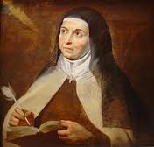
ST. TERESA OF AVILA
EXTREMELY GOOD AT INTROSPECTING
AND DESCRIBING HER EXPERIENCE

Slide 11
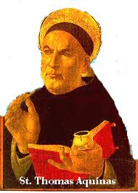
ST. THOMAS AQUINAS
HAD VERY GREAT CRITICAL
AND PHILOSOPHICAL ABILITIES

Slide 12
RELIGIOUS TRADITIONS OF MYSTICS AFFECTS THEIR INTERPRETATIONS
(i) Tradition of mystic affects how they interpret “a feeling of unity with the rest of the universe”
(ii) Tradition of mystic probably determines many of the details of the experience – e.g. visions of the Virgin Mary and of the saints by Roman Catholics vs. religious experiences by Protestants.

Slide 13
SIMILAR DOUBLE EFFECT IN ORDINARY SENSE PERCEPTION
(1) The interpretation of a visual or other perceptual experience is probably partly determined by the beliefs and expectations of the perceiver.
(2) The actual content of such an experience is to some extent also determined by the beliefs and expectations of the perceiver (Broad uses the philosophical terms ‘sensa’ and ‘sensum’)

Slide 14
SIMILARITY OF MYSTICAL EXPERIENCES OF NOT EXPLAINED BY THESE OBSERVATIONS
There are two alternatives open to us to explain these similarities:
The mystics are in contact with aspects of Reality not open to most of us.
(b) Mystics suffer from a kind of delusion (not open to other people)

Slide 15
THREE PARTLY ANALOGOUS ILLUSTRATIONS OF THESE POSSIBILITIES
Trained microscopists
(B) Persons of all races who drink alcohol to excess.
(C) Sighted people in the world of the blind (Thought experiment)

